Slide 1




BOOK TO FILM
THE PROFITABILITY OF CINEMATIC NOVEL ADAPTATIONS
By Maria Williams, Leo Corelli, Miranda Morris
Notes:
Hi guys! We are Maria, Leo and Miranda, and we were interested in what aspects of novels contribute to profitable film adaptations.

Slide 2

Should this book be a movie?
PROBLEM: 7/10 movies lose money
SOLUTION: Build a model to predict the profitability of book-to-film adaptations, since those are the movies that seem to be most profitable
TARGET USER: Movie studio executives
DEFINITION OF SUCCESS: an accurate (>.8 AUROC) model
Notes:
It turns out the movie business is a business of failures since 7/10 movies lose money for studios. We were hoping to create a ML model with an AUROC of at least .8, that can predict the profitability of film adaptations based on books factors. Hypothetically, this tool could be used by studios to help choose novels to option for screenplays.

Slide 3

Business Understanding
BACKGROUND RESEARCH:
Book adaptations earn over 50% more than original screenplays
Currently, books are mostly chosen based on novel profitability and instinct
EXPERT CONSULTANT:
Holly Frederick, literary agent
FACTORS:
Book Success:
Sales, awards, celebrity mentions
Story Adaptability:
Structure, characters, action
Expansion Potential:
Franchise potential
Global appeal
Trend
Notes:
Book adaptation do better than original screenplays, but still not consistently well, and there are no real hard rules about how to choose novels to adapt. Basically, if the book did well, the assumption is that the movie will do well. We were able to consult with Holly Frederick, who specializes in selling book right to studios who gave us some more insight.
Basically, the main factor studios are looking at is the book audience, then how easily it gets a adapted to movie, then its potential for expansion as well as some nebulous factors like, is it trendy

Slide 4
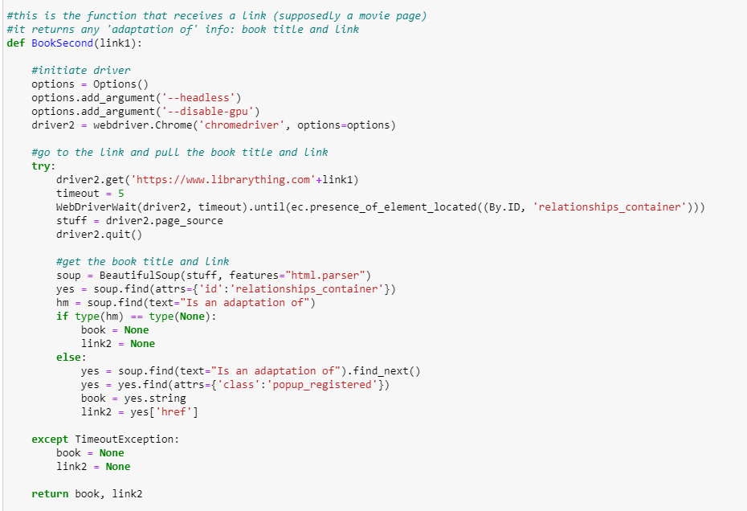
Data Identification and Sourcing
MOVIE DATA:
IMDb
Scraped list of films tagged as ‘based on novel’, released 1970-2021
Scraped pages for financial and story information
BOOK DATA:
Library Thing
Used movie list to search for movies and scrape adaptation information
New York Times Bestsellers List
Used API to pull list of bestsellers
Notes:
So where did we get this data? We looked at APIs and library sources, but we ended up mostly webscraping.
For movies: we were able to scrape a list of movies tagged as novel adaptations, then find the movies on that list in library thing and scrape the books that were tagged as their source material. Since LT did not have sales information, so we used the New York Times API to pull a list of books that were best-sellers, to cross reference. Once we had the data, we moved on to preparing and exploring it.

Slide 5
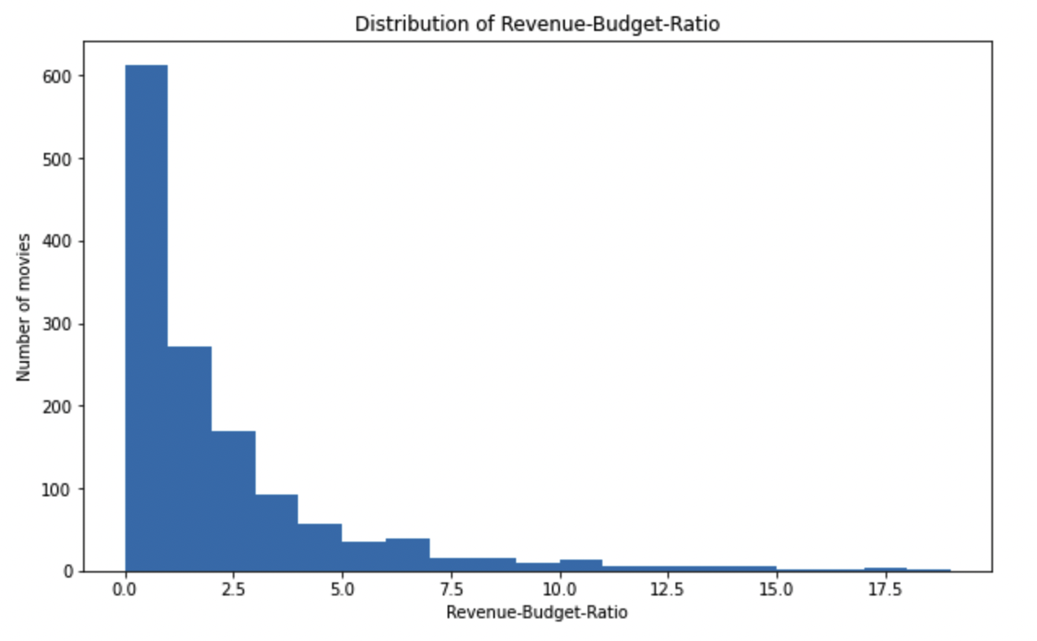
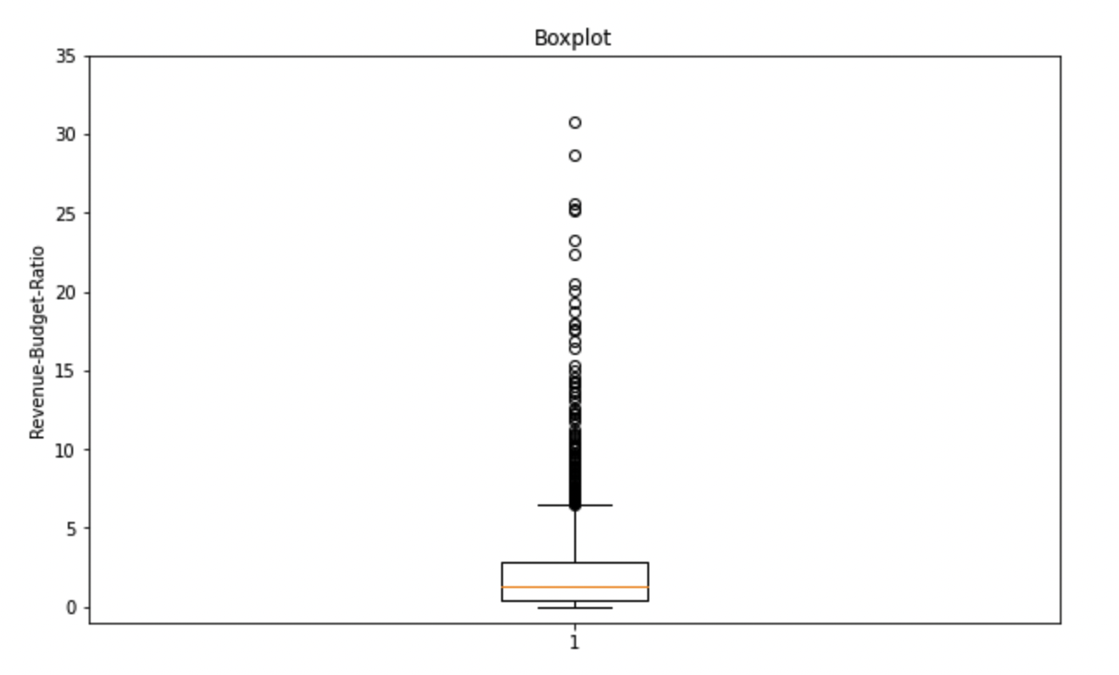
Data Preparation and Exploration
Perform analysis unbiased by studio size → set target = revenue to budget ratio
Highly concentrated around the 0-2 range, with a median of 1.3
The majority of movies lose money
Our data is representative of the real world distribution
A financially successful movie is an outlier
Manually inspect the largest outliers to validate that they were not erroneous entries
Notes:
To perform an analysis unbiased by studio size we created a ratio of revenue to budget as our target
Highly concentrated around the 0-2 range, with a median of 1.3
This makes sense → The majority of movies lose money
Our data is representative of the real world distribution
Since the financially successful movie is an outlier, we must include outliers
Manually inspected the 50 largest outliers to validate that they were not erroneous entries

Slide 6
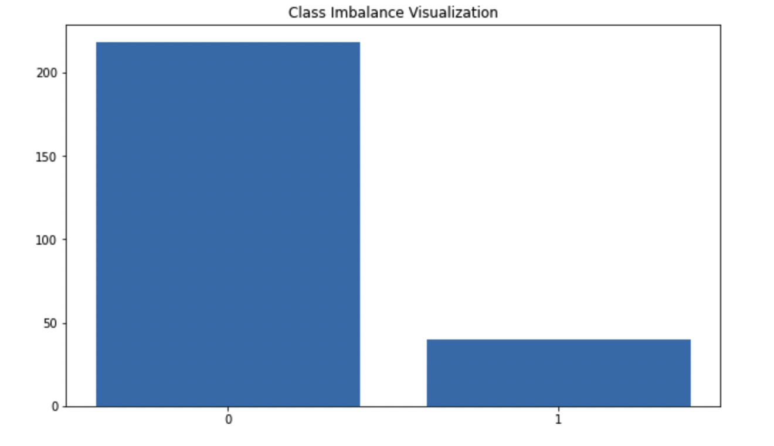
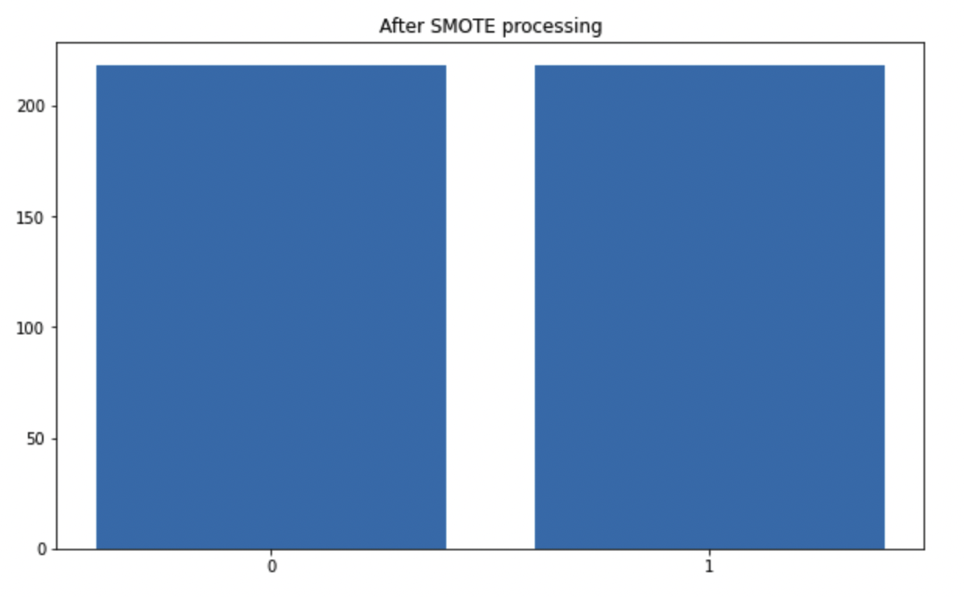
Data Preparation and Exploration (Cont.)
Transformed our continuous target ratios into binary classes of successful and not successful using a threshold value of 5
Budget makes up ~33% of a movie’s total cost
Used SMOTE (synthetic minority oversampling technique) in order to address class imbalance

Slide 7
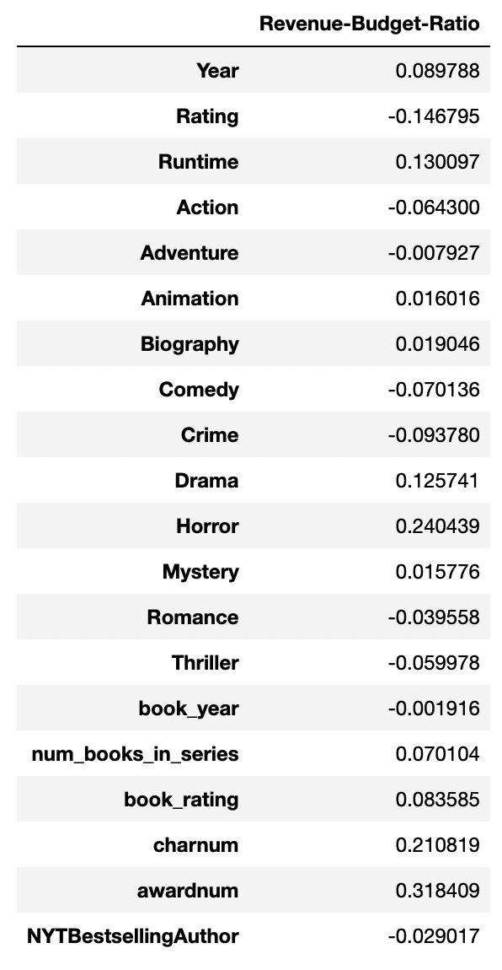
Analysis and Conclusion
Analysis:
With an average auroc of 0.57 and average positive class precision of 0.52, we were not successful
None of the features are strongly correlated with the target
Even features that the industry expects to have an impact are only weakly correlated
Potential Improvements:
More data: final dataset had < 1000 data points
More features: costs, specific awards, current trends, plot structure, changes made from books to movies, merchandising potential

Slide 8
Ethical and Regulatory Considerations
REGULATION: Transparent data collection; no privacy issues → all data is GDPR compliant
SAMPLE BIAS: Any tools created will depend on historical movie data, subject to existing biases in screenplays chosen and lack of diversity and representation in casting
PROFIT vs. PRIORITY: Prioritizing storytelling and artistry of filmmaking versus certain profitable characteristics (i.e. adding to already successful franchises)
Diversity is not historically profitable, but the film industry has responsibility as a key cultural institution to improve diversity, equity, and inclusion
UCLA Hollywood Diversity Report 2020: POC and women underrepresented as film writers and directors → overall helmed lower budget films
Notes:
No real privacy considerations - all data is GDPR compliant
In the development and refinement of our model, we did not encounter any privacy issues since all the data is GDPR compliant.
However, we came across a few ethical considerations, including the issue of sample bias and the ramifications of prioritizing profit.
While this tool aims to define profitable characteristics in films, we caution against making decisions based solely on those features, since it would likely reinforce the status quo of the industry and be antithetical to both creativity and diversity. Diversity is not historically profitable or well-represented, but as a cultural institution, we argue the film industry has a responsibility to propel our culture
In 2020, people of color constituted about 40% of lead actor roles in the UCLA Hollywood Diversity Report. However, people of color and women are still underrepresented as film writers and directors and typically helmed lower-budget films.
FAT? Fair, accountable, transparent?
Transparent: yes

Slide 9
Summary
01
Business Understanding
The profit potential of movies is currently estimated by the book’s financial success and its franchise potential
02
Data Understanding
Financial data is limited and not often public, and relevant books factors need feature engineering
03
Data Preparation
We calculated profitability and transformed many factors with ordinal and one-hot encoding
04
Modeling
Complicated models displayed overfitting, favoring a simple logistic regression model to better generalize the data
Currently very difficult to predict movie profitability given hidden factors (i.e. costs, trends, branding) & intangibles (i.e. casting decisions, actor chemistry)
05
Evaluation
06
Deployment
Significantly more financial and story-related data will be needed to be made available to create a useful tool

Slide 10

End Credits
THANK YOU!
Data Sources:
https://www.imdb.com
https://www.librarything.com
https://developer.nytimes.com
Research Sources:
https://www.gramercybooksbexley.com/blog/what-books-make-good-films
https://medium.com/publishing-in-the-digital-age/book-to-film-adaptations-caec7c65e96a
https://www.forbes.com/sites/adamrowe1/2018/07/11/why-book-based-films-earn-53-more-at-the-worldwide-box-office/?sh=7419421306f0
https://newsroom.ucla.edu/releases/2021-hollywood-diversity-report

